Slide 1
Introduction to R and machine learning using raman spectroscopy
Freya Woods

Slide 2
What we’ll cover
Introduction to Raman spectroscopy
The data we’ll be exploring today
Why R?
Introduction to R studio
Data manipulation and visualisation in R
Principle component analysis
K-means clustering

Slide 3
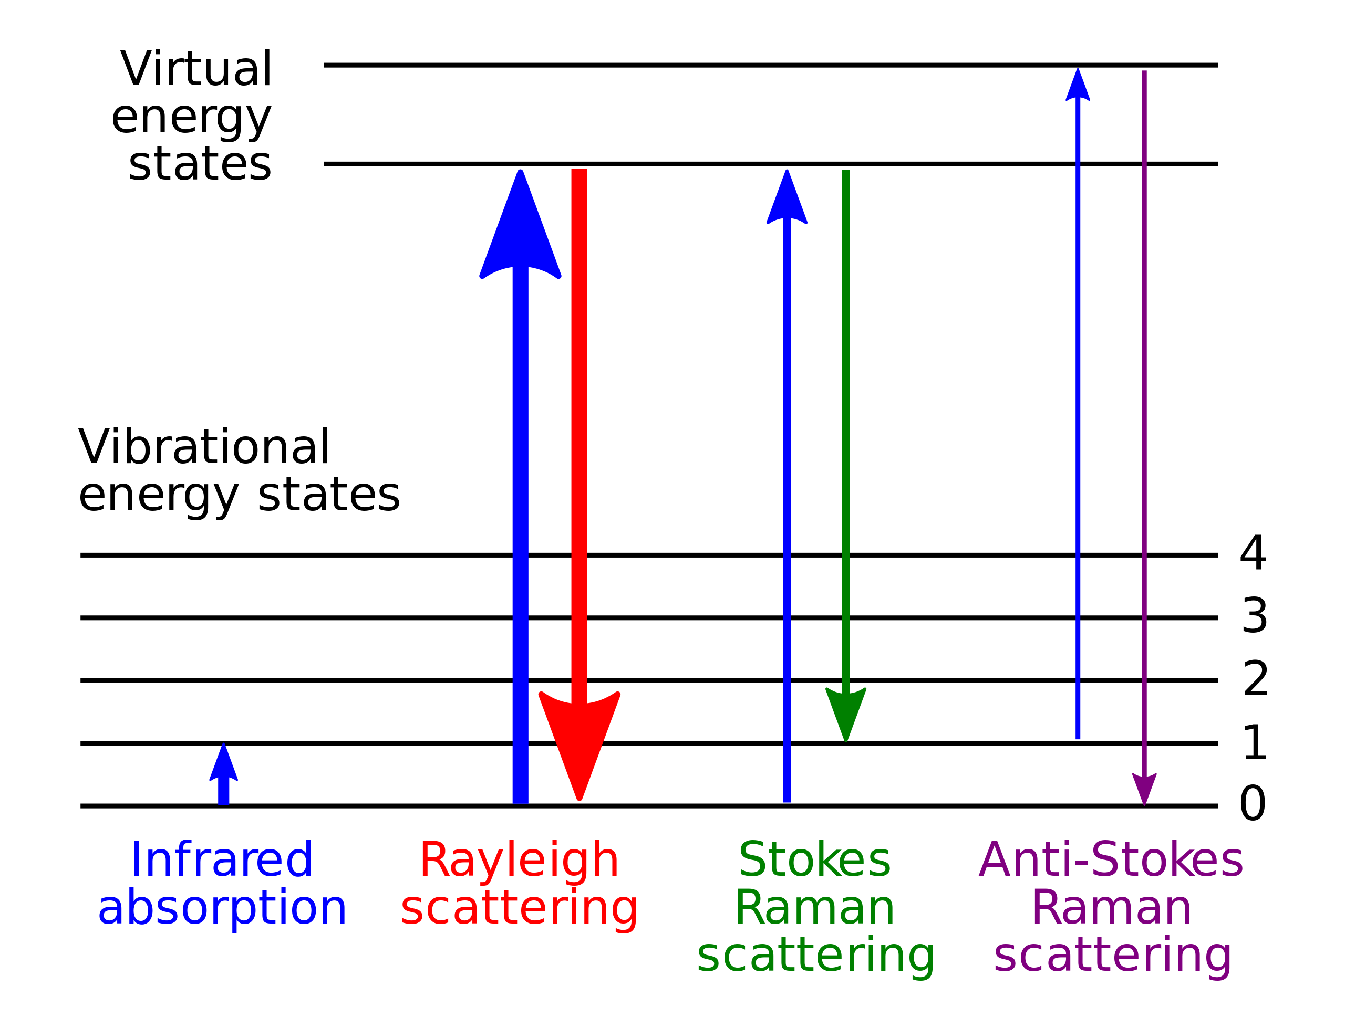
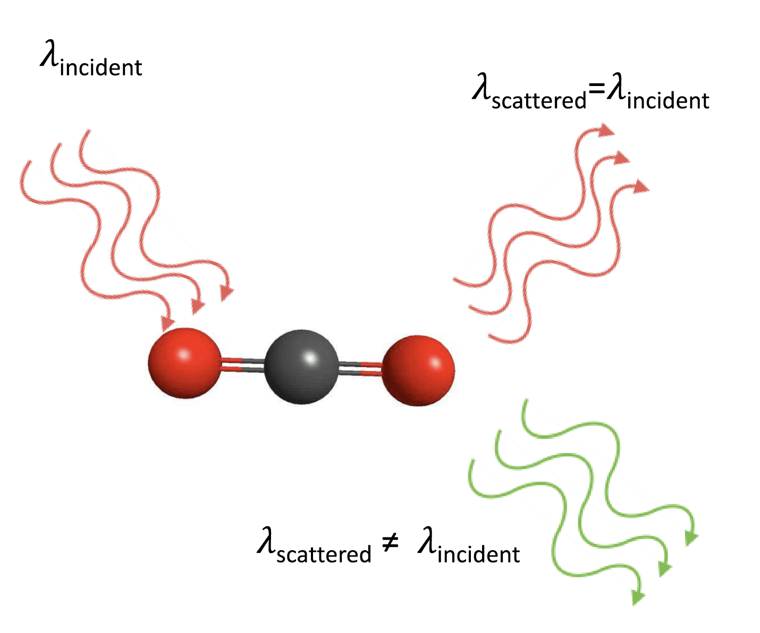
Raman Scattering
Type of vibrational spectroscopy
Use photons to stimulate vibrations in molecules
Detect inelastically scattered light due to Raman effect

Slide 4
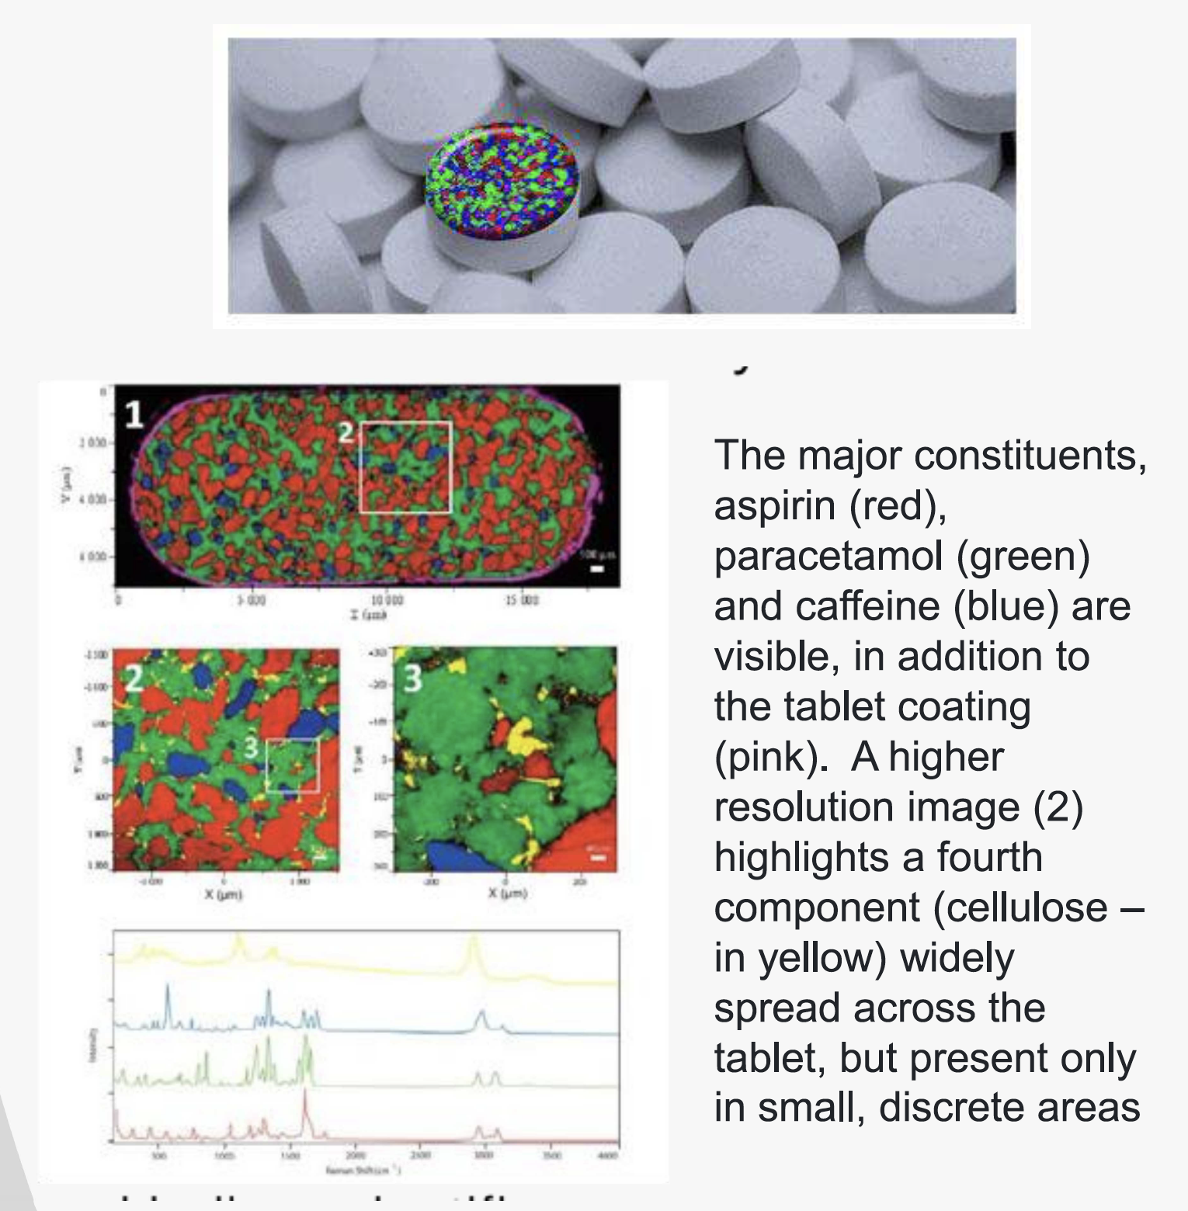
Why is Raman useful?
- Non-destructive method for sample analysis
- Sensitive to small changes in molecular structure
- Can be used for quantitative analysis
- Not affected by water – can do wet analysis

Slide 5
Raman of Biofluids
Non-destructive method (if used carefully)
Can couple machine learning with Raman spectroscopy for disease identification

Slide 6
Data we’re looking at today
- Blood serum spectra from 12 patients
- 6 have colorectal cancer, 6 are controls samples
- There are 5 repeat spectra per patient, so we have 12*5 spectra = 60
- The data is structured such that:
1. the first row contains the wavenumber (x axis)
2. each subsequent row contains the spectrum of one repeat
3. Column V1016 contains the diagnosis (”Cancer” or “Control”)
4. Column V1017 contains the ID
V1 | V2 | … | … | … | V1016 | V1017
Wn[1] | Wn[2] | … | … | … | Diagnosis | ID

Slide 7
Why R?
- Open source, hundreds of user contributed packages with code to use
- Similar to Python in terms of functionality
- Used in all areas, from industry to research to public sector
- Go to language for statistics and data science, huge support online
- One big downside for me: base R’s plotting is not great, BUT ggplot2, plotly developed to create nice publication ready plots

Slide 8
Coding segment 1
Open a blank R script, have your data in a folder you can navigate to
And let’s code!

Slide 9
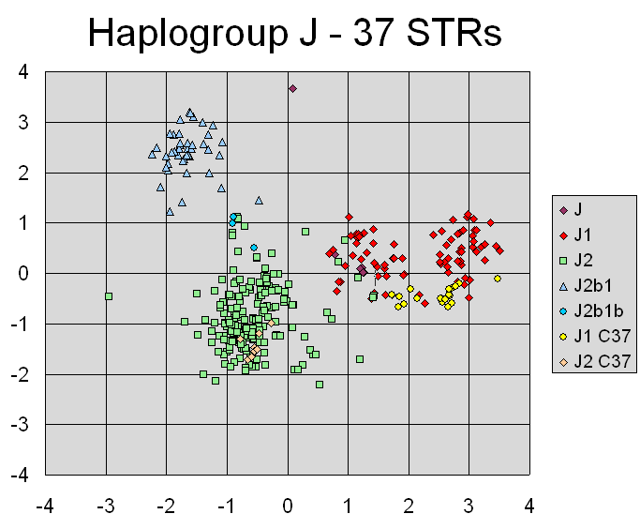
Principle Component Analysis (PCA)
- In our Raman spectra, we have 1015 variables that we might see differences between Cancers and Controls
- Is there a way to reduce this to fewer variables while maintaining variance?
- PCA!
- Finding such new variables, the principal components, reduces to solving an eigenvalue/eigenvector problem, and the new variables are defined by the dataset
Source: setosa.io
Source: PCA on wiki – showing an application in genetics, clustering of types of y-chromosome alleles

Slide 10
Coding segment 2
Feel free to use the pre-made scripts provided, or continue from your previous script
And let’s code!

Slide 11
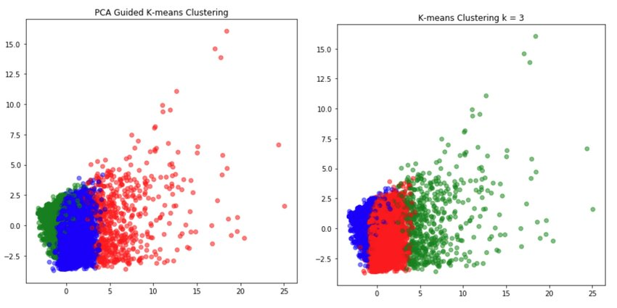
K-means Clustering
- K-means clustering is a machine learning technique
- it’s known as an unsupervised method, meaning we don’t give it knowledge of the classes, just the data
- By computing the distance from one data point to all other data point, we can estimate where clusters arise
- We can then use the model to test new data, and see which cluster it fits into best

Slide 12
Coding segment 3
And let’s code!

